Slide 1


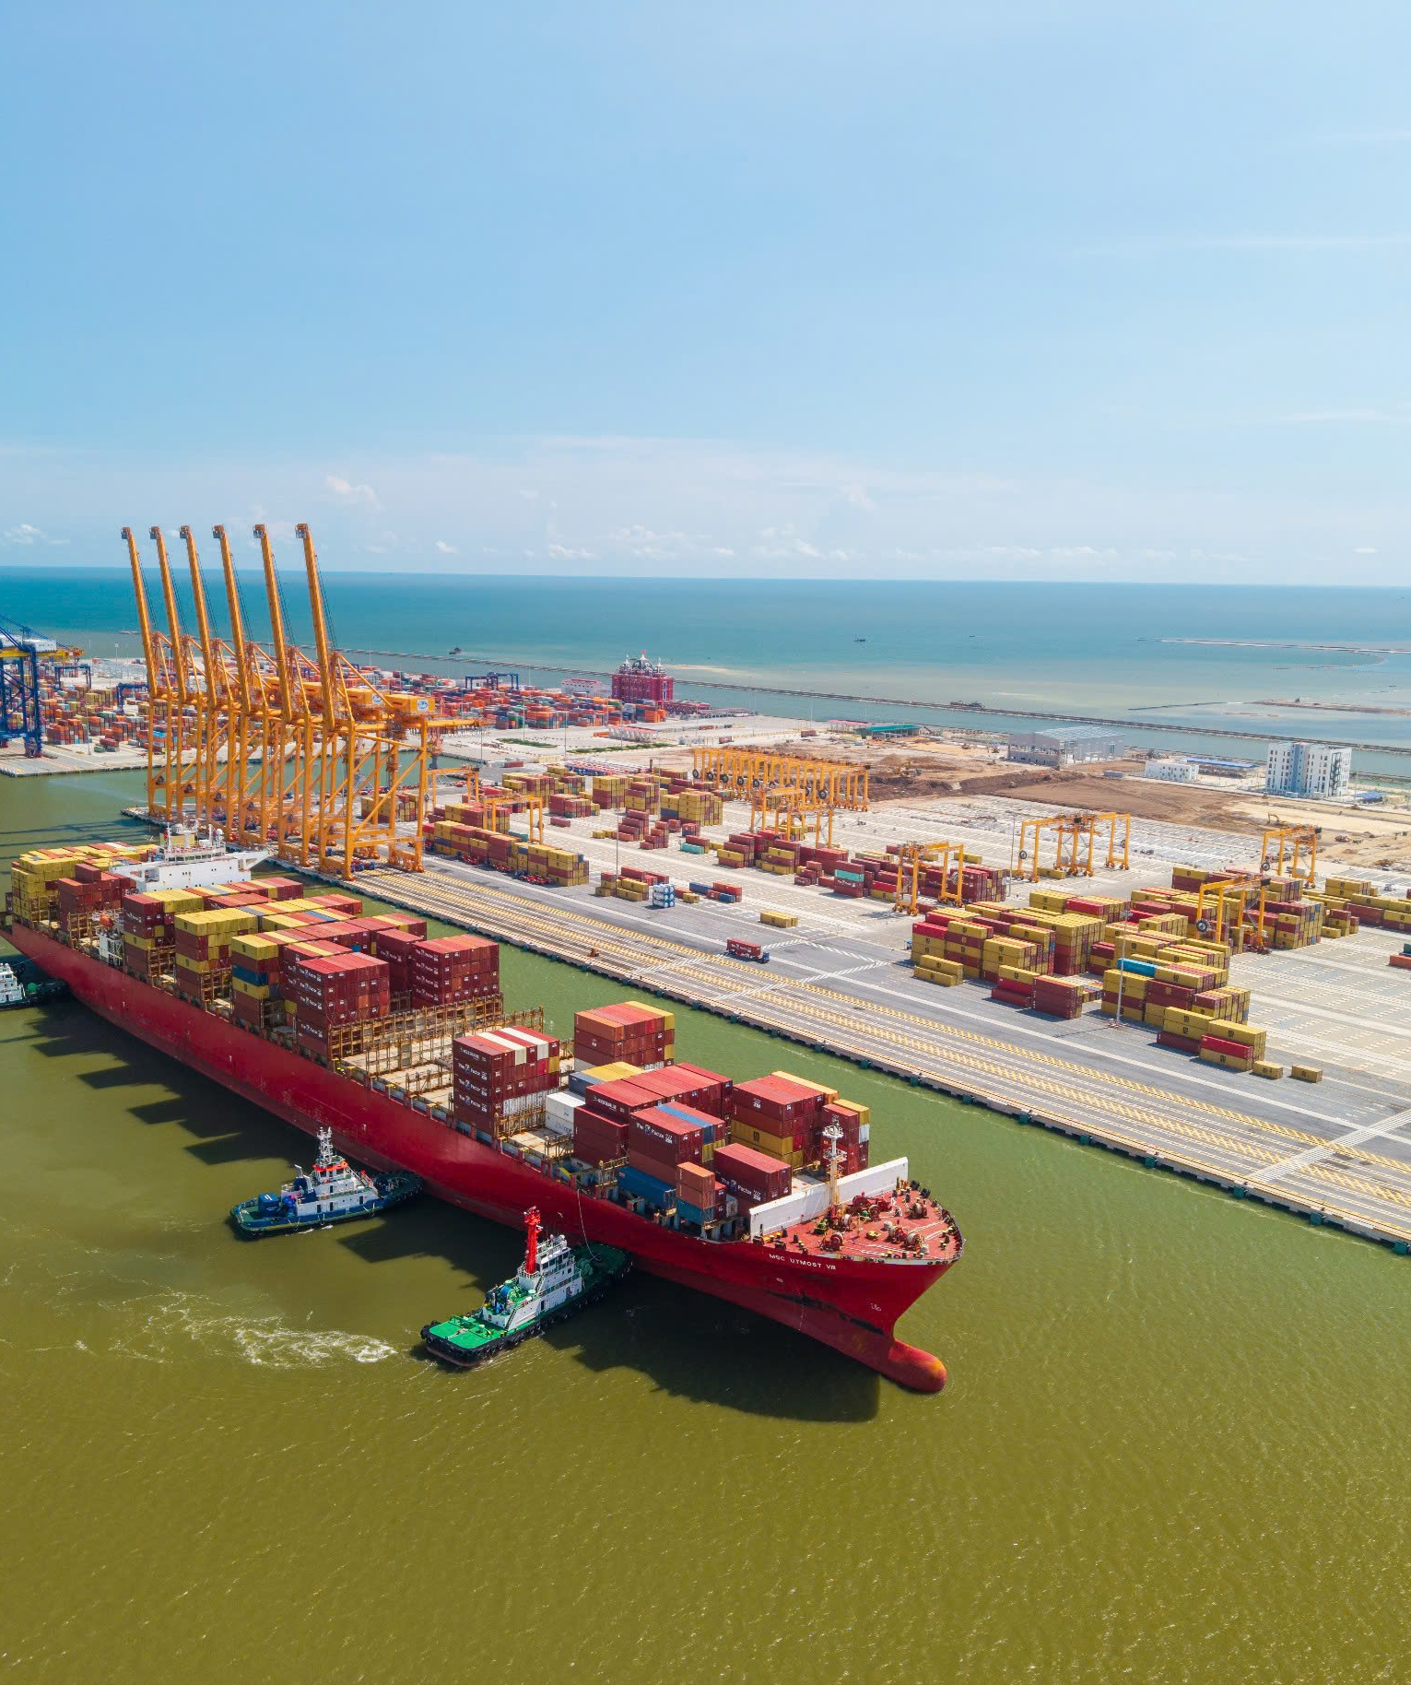
HAIPHONG PORT TIL INTERNATIONAL TERMINAL
“Gateway to the World - Foundation for Sustainable Trade Flow”

Slide 2
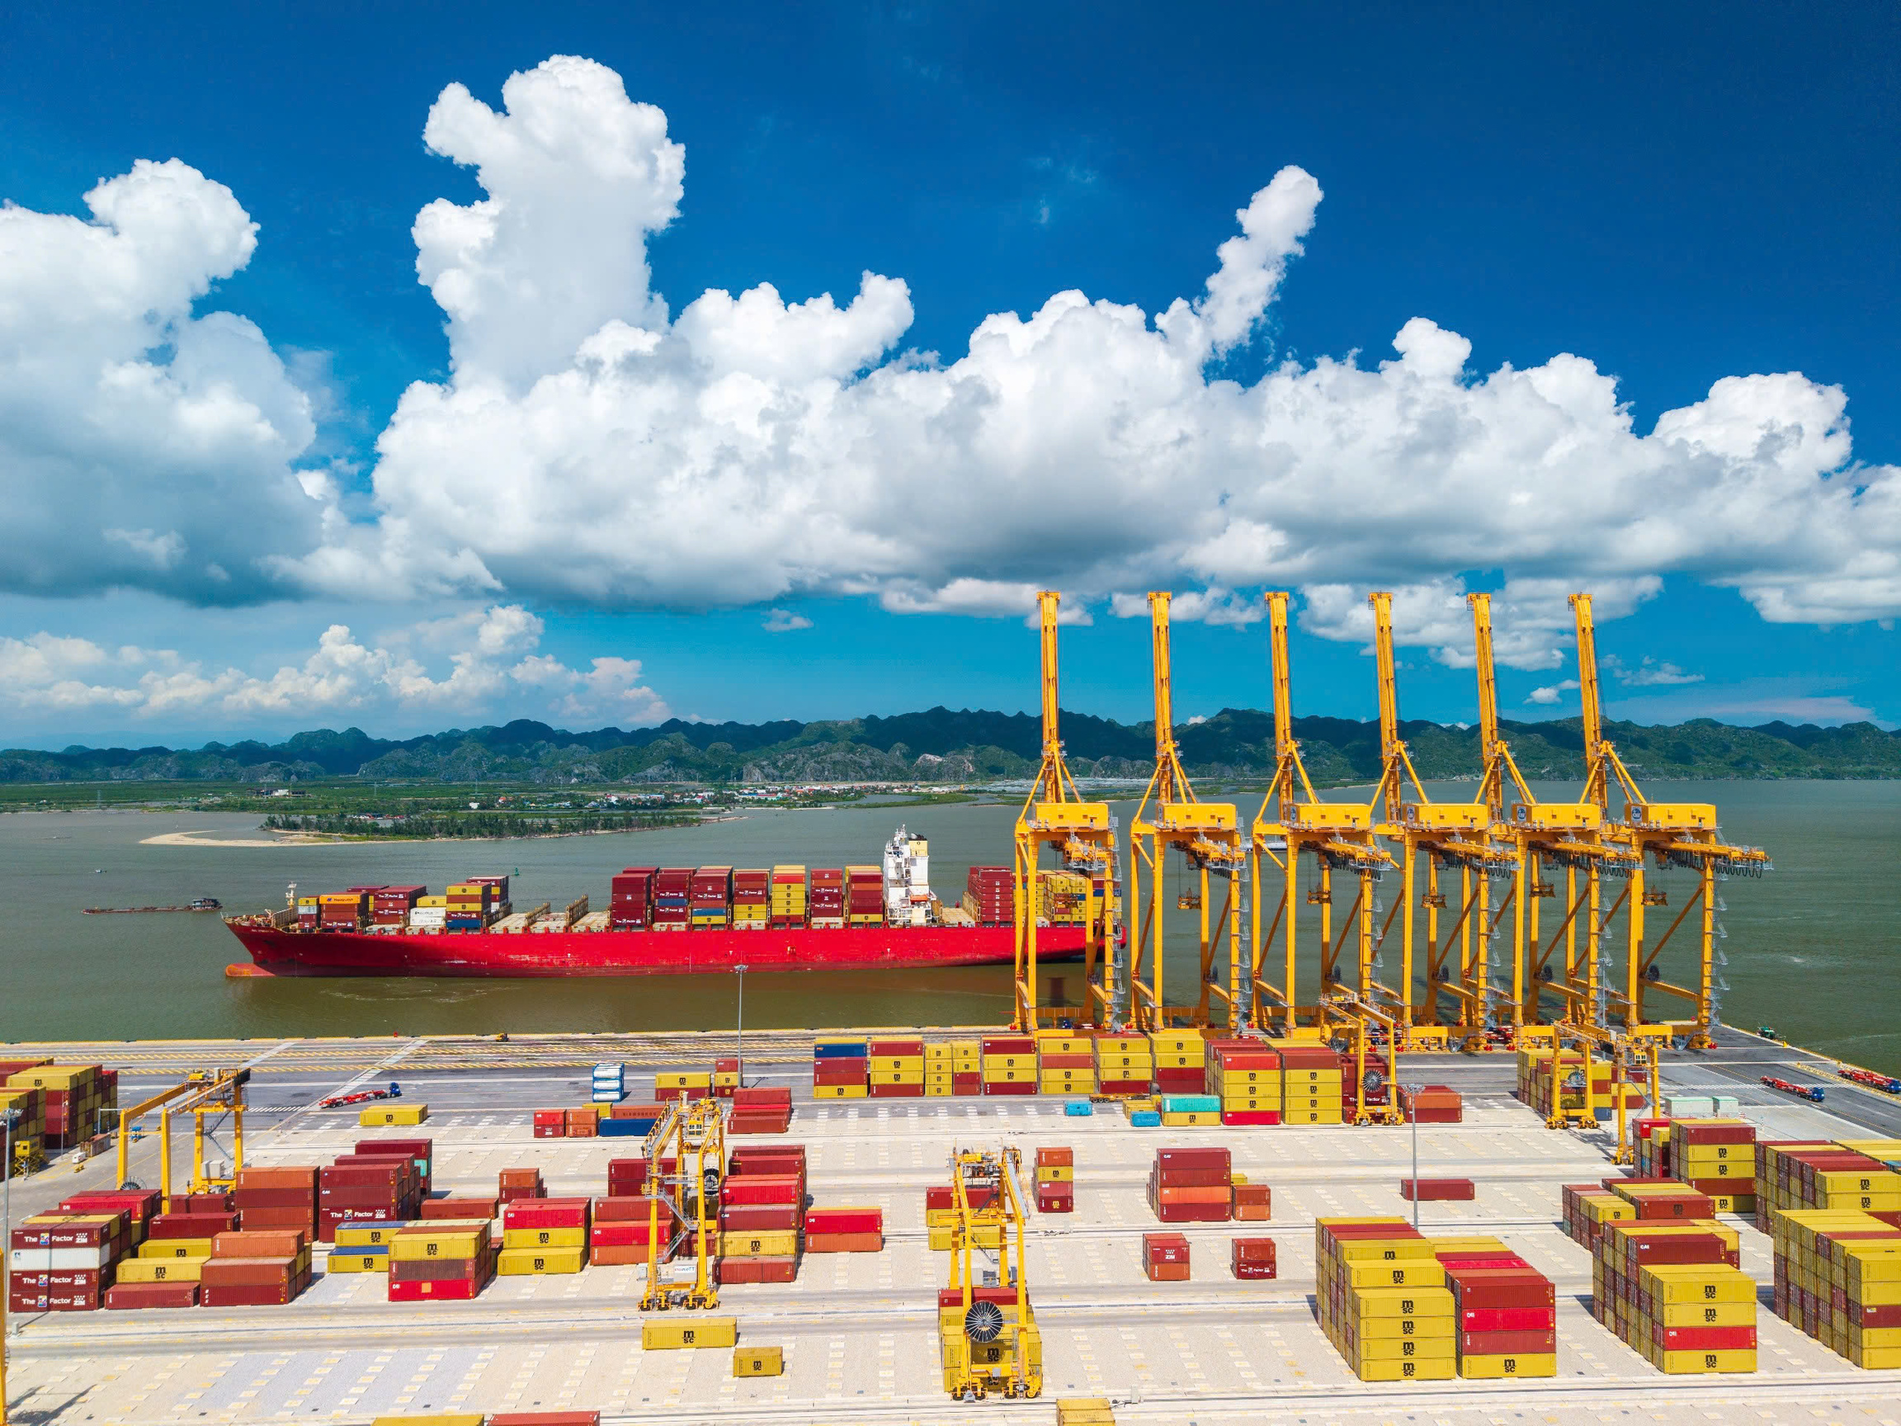
01
01
GENERAL INFORMATION

Slide 3

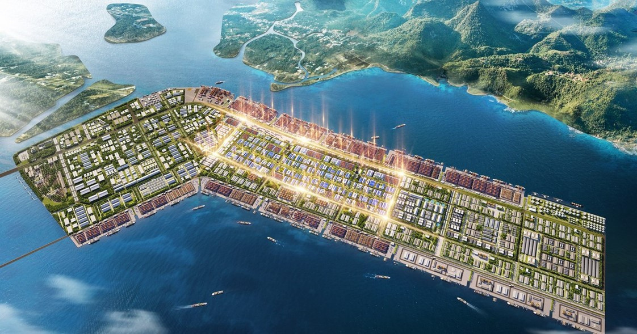




HTIT’S GENERAL INFORMATION
HICT Berth No. 01 & 02
HTIT Berth No. 03 & 04
Hateco Berth No. 05 & 06
LOCATION &
MASTERPLAN
SNP Berth No. 07 & 08
20 berths for container and general cargo & 2 berths for liquid (as estimated in 2050)
    Company name: Haiphong Port TIL International Terminal Company Limited
    Abbreviation name: HTIT
    Established: December, 2024
    Location: Berth No. 03 & 04 – Lach Huyen deep-sea Port, Haiphong city, Vietnam

Slide 4
HTIT BERTH NO.3 & 4
TOTAL LAND AREA
MAIN BERTH
CHANNEL DEPTH
ALONGSIDE DEPTH
47 HA
750 M
-14 M
-16 M + TIDE LEVEL (0 ~ 4 M)
VESSEL ACCOMODATION
BARGE BERTH
BARGE
CAPACITY
165,000 DWT
150 M
3,000 DWT - 160 TEUS
1,350,000 TEUS/ YEAR
CY
REEFER
30,3 HA (~42,000 TEU)
864 REEFER SOCKETS
SPECIAL CONTAINER
WEIGHT BRIDGE
50 SLOTS
02 UNITS (UP TO 120 TONS)

Slide 5



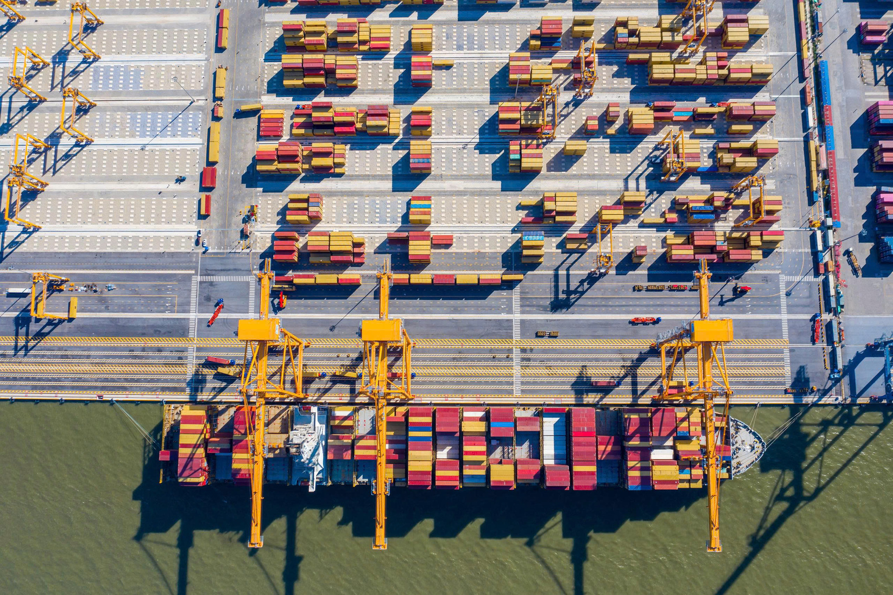
HTIT BERTH NO.3 & 4
BY ROAD
Via Tan Vu – Lach Huyen bridge: the longest sea-crossing bridge in Vietnam with 5.44 km length, 16 m width, 4 car lanes.
Tan Vu - Lach Huyen 2 Bridge Project (2026 – 2030): 51 m width including 6 motor vehicle lanes and
4 mixed lanes.
INLAND WATERWAY BARGE
Barge service connecting HTIT with river ports within 10 nautical miles.
LAO CAI - HANOI - HAI PHONG
RAILWAY PROJECT
388 km long, connecting the Hekou railway (China) with Lao Cai (Vietnam).
Through 8 provinces and cities including: Lao Cai, Yen Bai, Phu Tho, Vinh Phuc, Hanoi, Hung Yen, Hai Duong and Hai Phong; the end point is at Lach Huyen port (Hai Phong).

Slide 6
HTIT BERTH NO.3 & 4
STAGE 1 (START OPERATING FROM APRIL 1ST 2025)
• Berth: No.3 (375m length)
• CY area: 06 ha
• STS: 03 units
• E-RTG: 08 units
• Reach stacker: 03 units
• Terminal truck: 30 units
• Vessel accommodation: 100,000 DWT
>
STAGE 2 (START OPERATING FROM JULY 1ST 2025)
• Berth: No.3 + 4 (750 m length)
• Barge berth: 150m (3000 DWT)
• CY area: 15 ha
• STS: 06 units
• E-RTG: 16 units
• Tukan: 02 units
• Reach stacker: 03 units
• Terminal truck: 50 units
• Vessel accommodation: 165,000 DWT
STAGE 3 (START OPERATING FROM JAN 1ST 2026)
• Berth: No.3 + 4 (750 m length)
• Barge berth: 150m (3000 DWT)
• CY area: 30.3 ha
• STS: 06 units
• E-RTG: 24 units
• Tukan: 02 units
• Reach stacker: 03 units
• Terminal truck: 50 units
• Vessel accommodation: 165,000 DWT
>

Slide 7

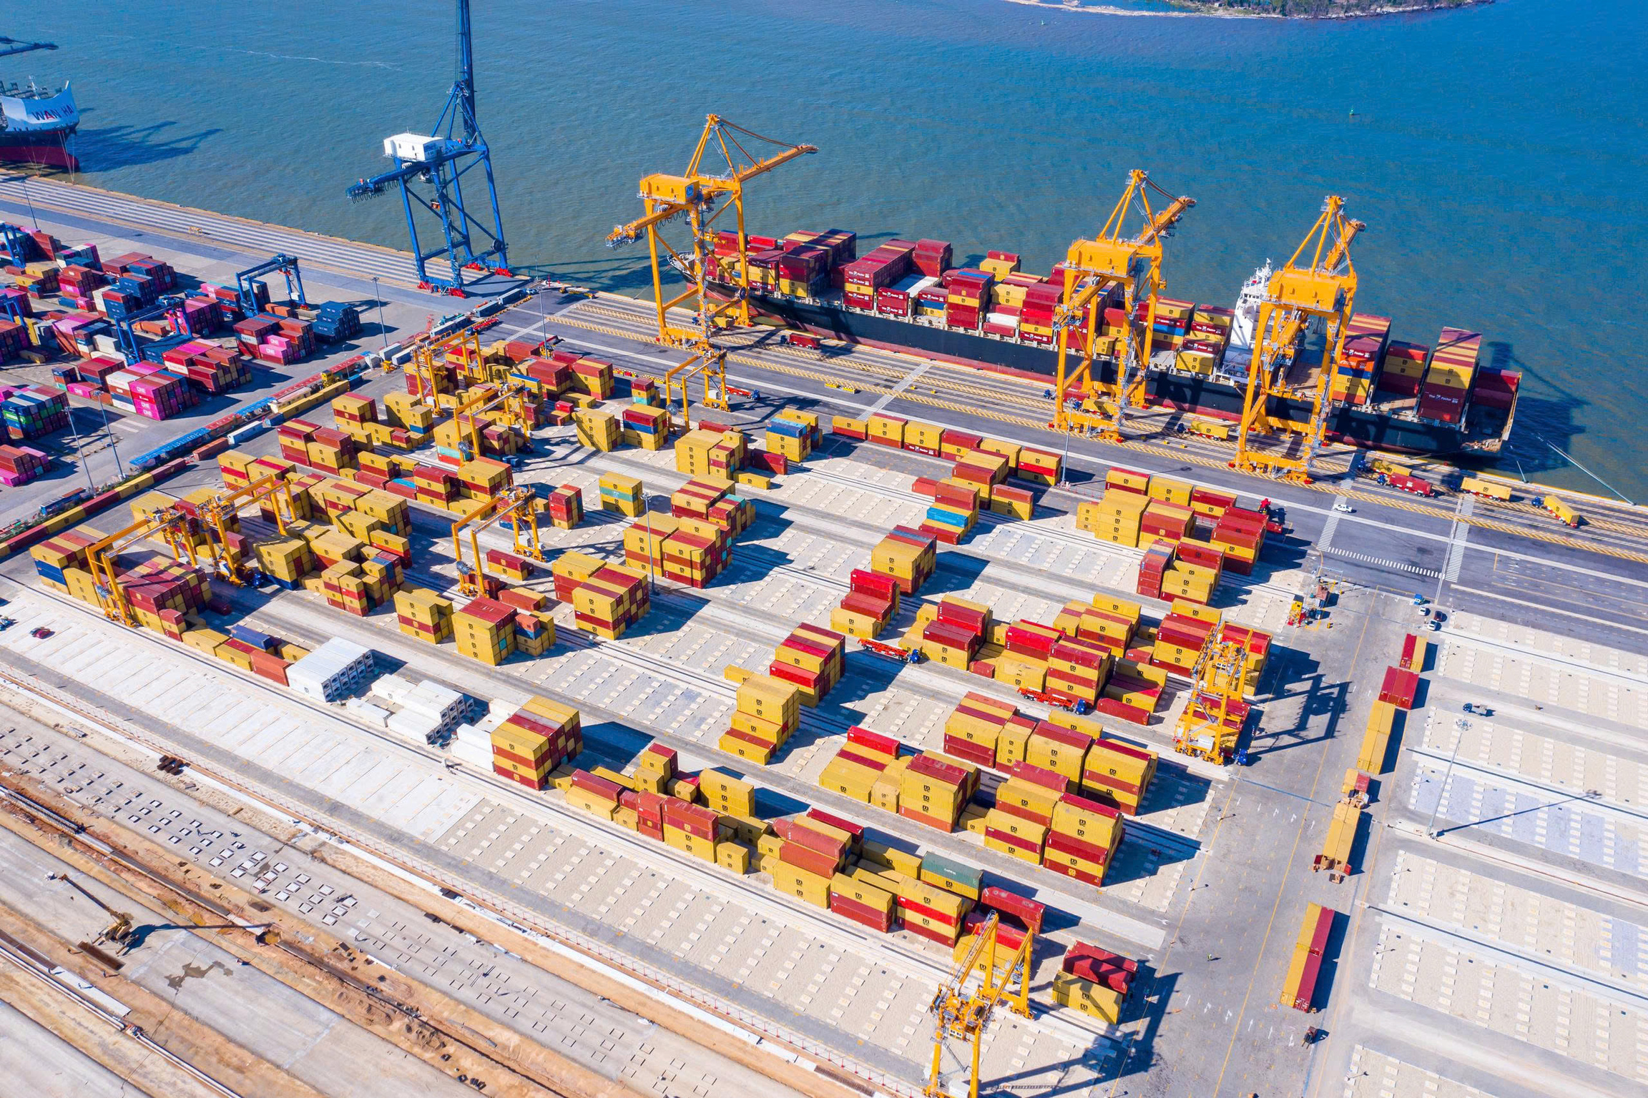
02
INFRASTRUCTURE
02
& OPERATIONS

Slide 8
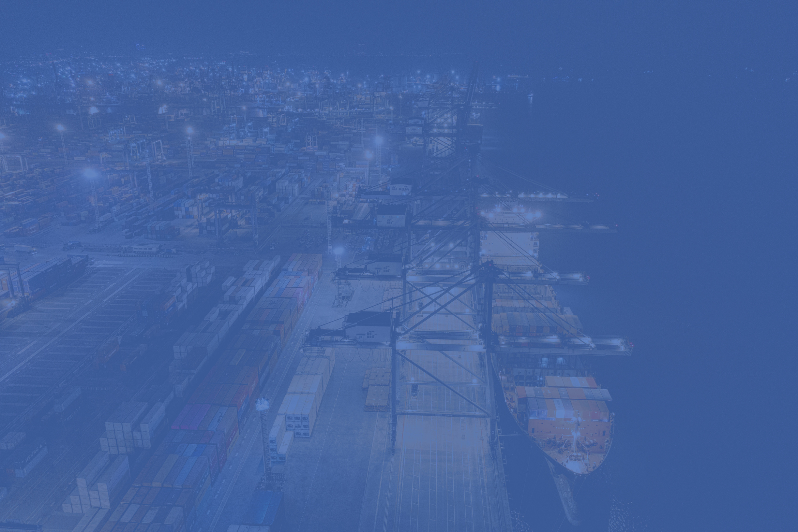
INFRASTRUCTURE AND OPERATIONS
01
02
03
STS
E-RTG
  STS 6 Units
  OUTREACH 64m (Equal to 24 rows of containers)
  Lifting Height 46m
  Single Lifting Weight 40 tons
  Twin Lifting Weight 65 tons
SLEWING PORTAL CRANE
  24 Units
  Span (Non- rail): 23.47M (Equal to 6 rows of containers +1)
  Lifting weight 18M (Capable to handle 5 high container tiers +1)
  Lifting weight 40 tons
  02 Units
  Outreach 32m
  Lifting weight 45 tons
04
05
YARD EQUIPMENT
  Truck: 50 Units
  02 Reach stackers for laden (5 high container tiers)
  01 Reach stackers for empty (6 high container tiers)
  02 Weight bridges up to 120T
INFORMATION TECHNOLOGY
  Catos system
  E- port service (ePort, EBK)
  Auto- gate (Smart gate)

Slide 9
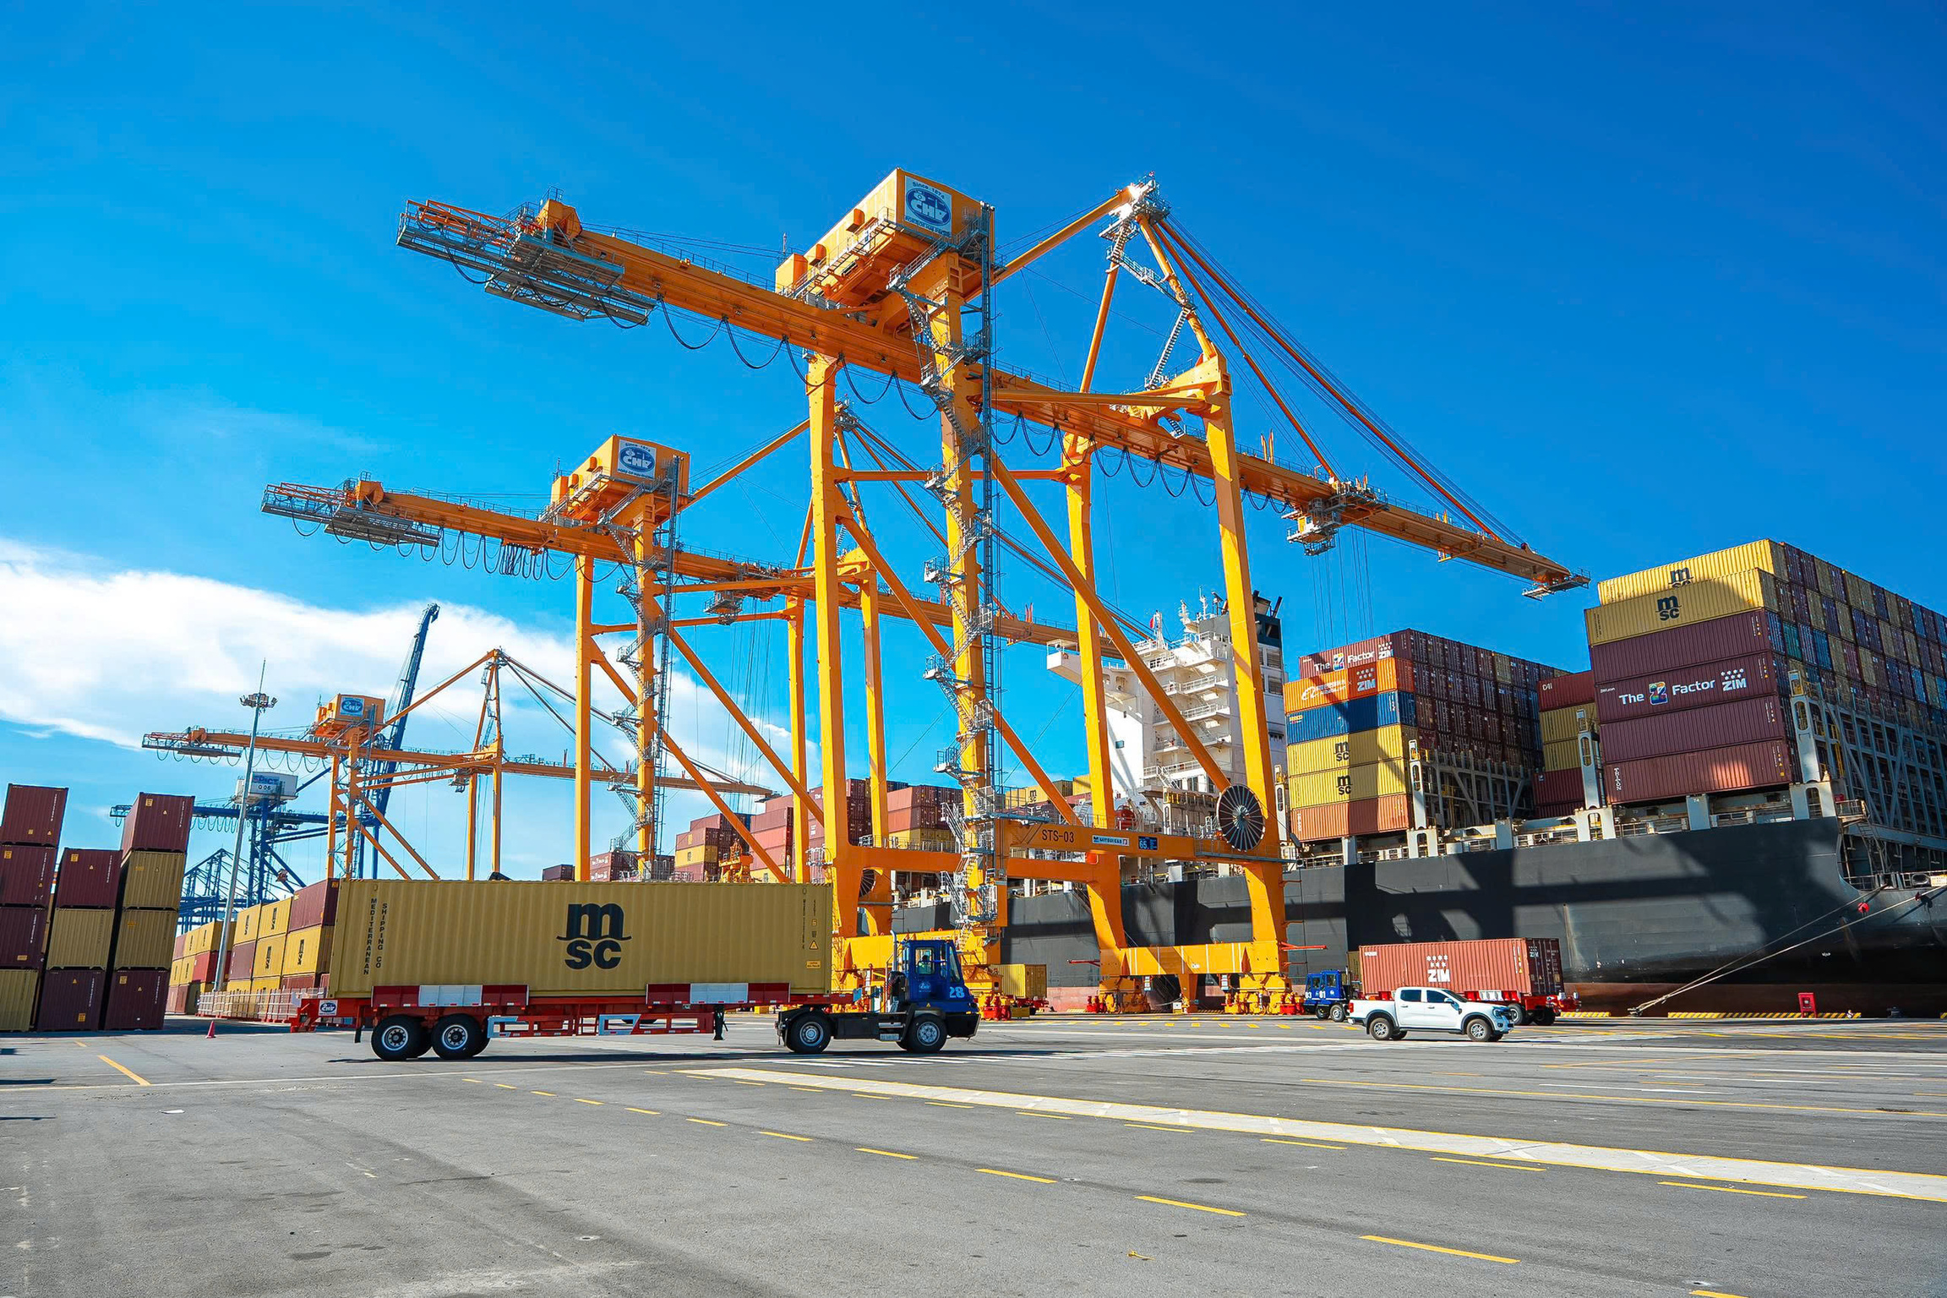
03
KEY ADVANTAGES
03

Slide 10

KEY ADVANTAGES
01
02
03
JOINT VENTURE OF
HAIPHONG PORT AND (TIL/MSC)
OPTIMIZE COMMUNICATION IN OPERATIONS
APPLIED DUAL CYCLING TECHNIQUE
Features world-class terminal technology, with automated operations and global-standard planning systems that ensure high quality vessel operation.
Apply foot-activated radio systems (foot-switch) , enabling hands-free, real-time communication. Enhances safety, shortens response times, and ensures smooth coordination during high-intensity operations.
HTIT is the first terminal in Vietnam to fully implement the cycling technique, enabling simultaneous container drop-off and pick-up under one crane. This significantly cuts handling time, boosts productivity, and sets a new standard in operational efficiency.
04
05
CERTIFIED WORKFORCE,
WORLD-CLASS STANDARDS
LEVERAGE VIMC–HPP ECO-SYSTEM STRENGTHS
HTIT’s workforce is trained by top-tier industry experts and certified to meet international operational standards. Our goal is to build a highly skilled team, aiming for Vietnam’s top-tier terminal performance benchmark.
An extensive network closely connected with VIMC Eco-system and POH’s terminals (Tan Vu, Dinh Vu terminal).

Slide 11
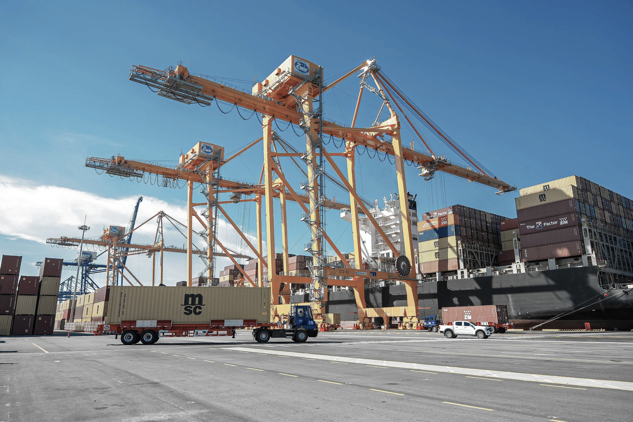


KEY ADVANTAGES
Leading the Northern Gateway with Modern Infrastructure, Smart Operations, and Strategic Positioning
Deep-water access (up to 165,000 DWT):
Ready for the world’s largest container vessels.
Modern equipment & advanced IT systems: STS cranes with 24-row outreach, integrated TOS & ePort.
Prime location in Lach Huyen Port Zone: Seamless connection to industrial zones and national expressways.
Integrated logistics services:
From terminal handling to depot, repair, warehousing, trucking, customs...
Fast, efficient, and transparent operations: Digital workflows ensure high productivity and real-time updates.
Competitive tariffs & customer-centric support:
Tailored services and commercial incentives for shipping lines.
Experienced management team: Backed by VIMC’s expertise in logistics and infrastructure.

Slide 12
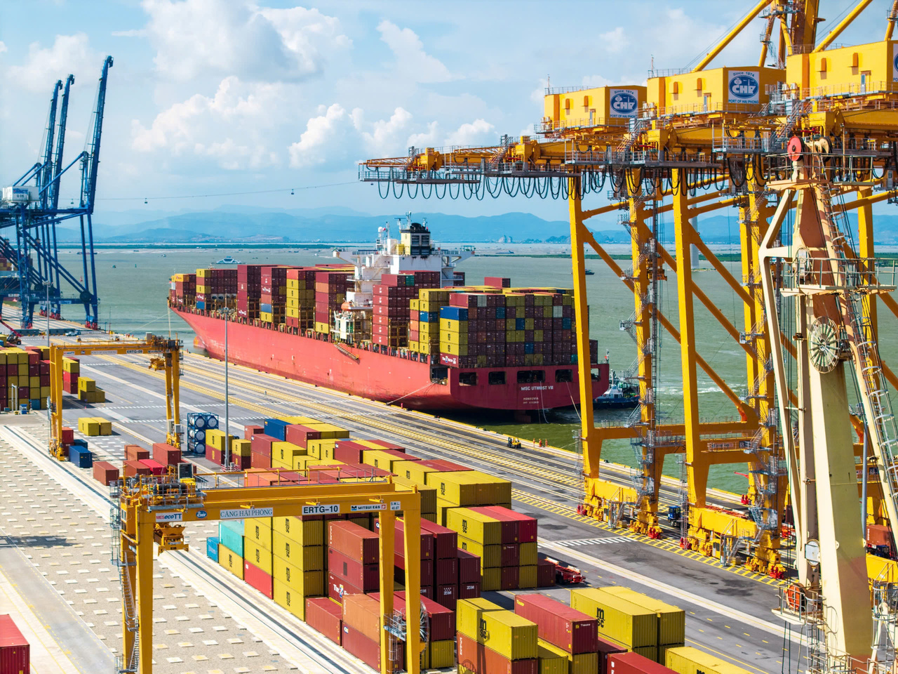
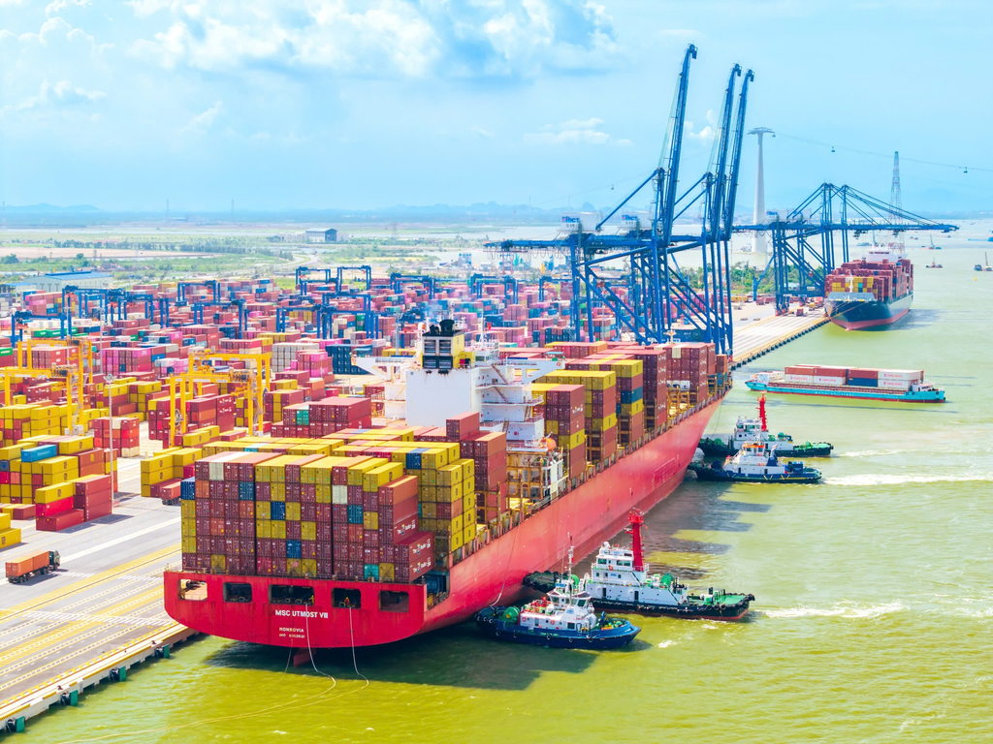
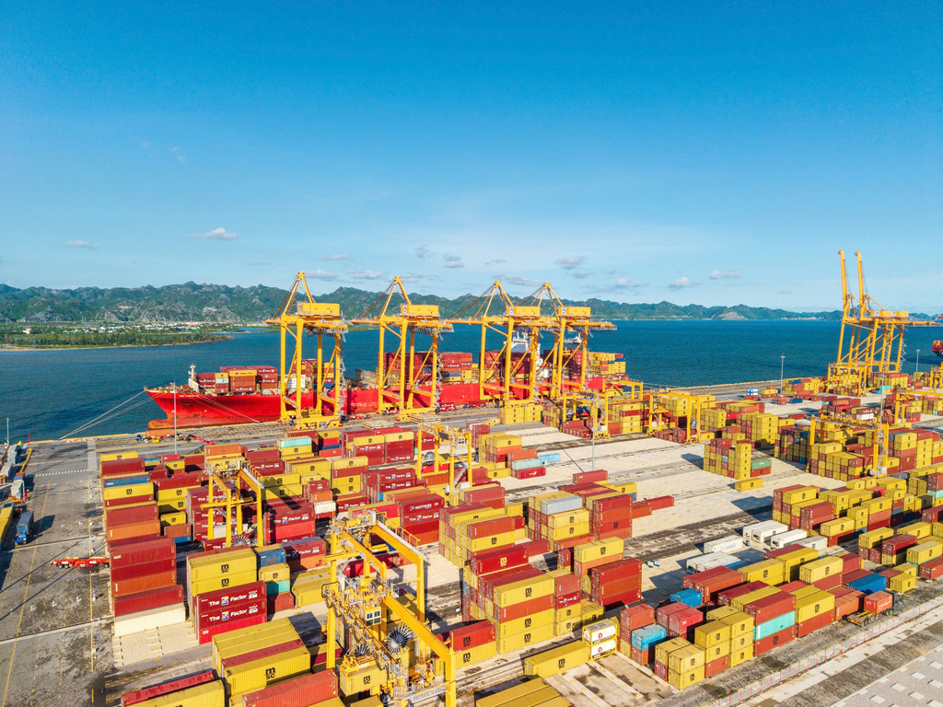
GALLERY

Slide 13

Thank You!
www.htit.com.vn

